Slide 1
Rutter Lab Isolation Bootcamp
#1: Introduction to the command line
Slides with “ARQ” are copied or adapted from Aaron R. Quinlan

Slide 2
Access the slides and files here:
https://github.com/j-berg/rutter_lab_coding_bootcamp
Or go to Lab Info on fileserver

Slide 3
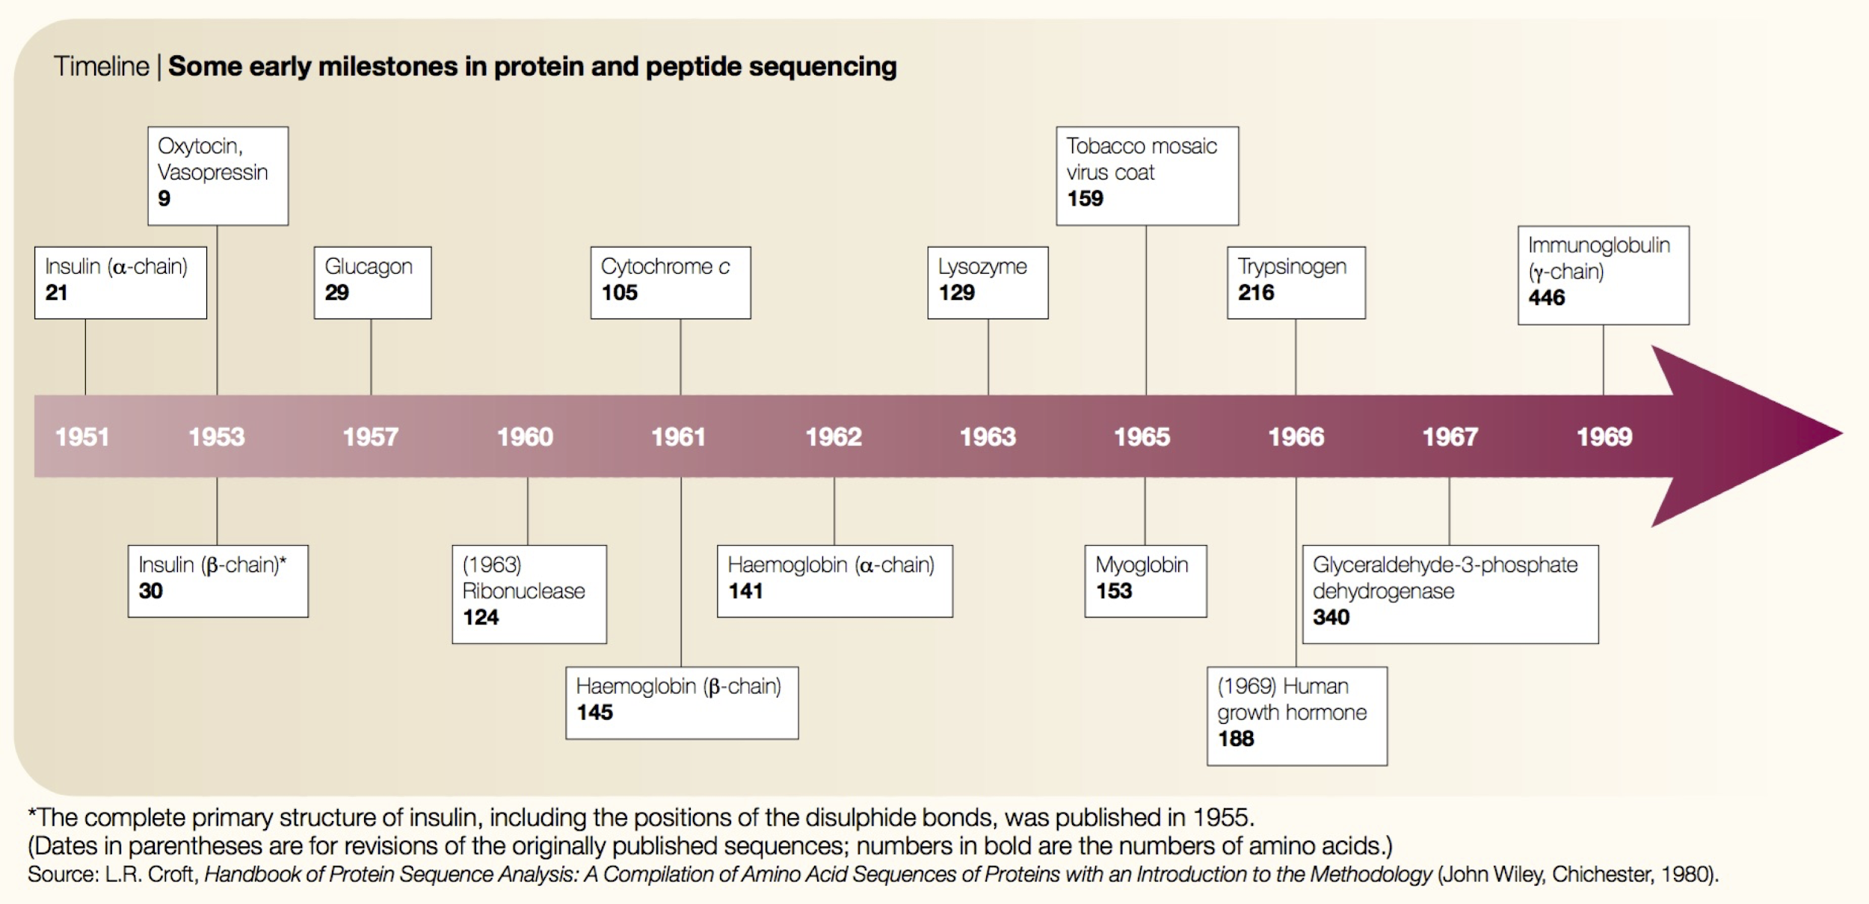
Comp. biology was born in the 1960s
ARQ
Expanding collection of amino acid sequences in the 1960s
Need for computational power to answer questions and study protein biology
Scarcity of academic computers was no longer a major problem
Joel Hagen, “The origins of bioinformatics”, NRG, Dec. 2000

Slide 4

What is Unix?
ARQ
Definition 1: Unix is not an acronym; it is a pun on "Multics". Multics was a large multi-user operating system that was being developed at Bell Labs shortly before Unix was created in the early '70s. Brian Kernighan is credited with the name.
Definition 2: Where computational genomics is done.
Definition 3: Your dear friend.
Recommended reading: “The Evolution of the Unix Time-sharing system”, Dennis M. Ritchie https://pdfs.semanticscholar.org/f64f/6e66da16e93ebf4221fc8915b2420fd56b66.pdf

Slide 5

Unix history
ARQ
Ken Thompson (sitting) and Dennis Ritchie working together at a PDP-11
Initial file system, command interpreter (shell), and process management started by Ken Thompson
Device files and further development from Dennis Ritchie, as well as McIlroy and Ossanna (to a lesser degree)
Vast array of simple, dependable tools that each do one simple task.
By combining these tools, one can conduct rather sophisticated analyses
Wildly popular platform for high performance computing. Supports parallelism.
SunOS/Solaris, IBM's AIX, Hewlett-Packard HP-UX, OSX, Linux, Android, etc.
Credit:https://en.wikipedia.org/wiki/History_of_Unix

Slide 6
Unix basics
ARQ

Slide 7
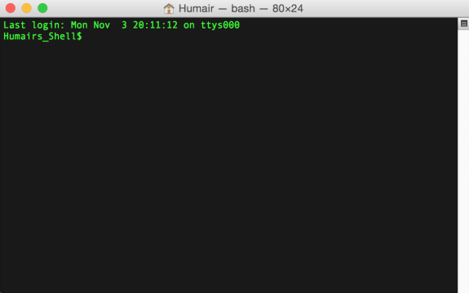
Connecting to a Unix computer via the terminal
ARQ
“Terminal” in OSX

Slide 8
The “prompt”
ARQ
The prompt is just a patient little thing that waits around for you to tell it what to do via “commands”.
Command syntax must be exact. In this way, Unix is dumb. It cannot infer what you meant if you misspell, provide the wrong syntax, etc.

Slide 9

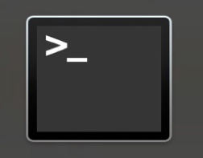
Launching OSX “Terminal”
ARQ
Applications
Utilities
Terminal

Slide 10
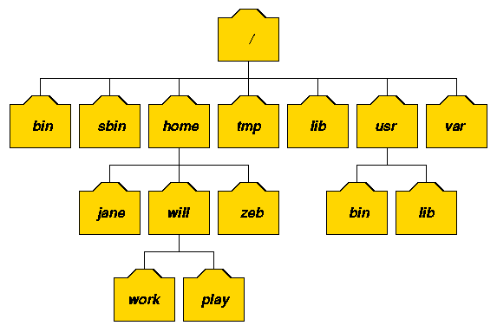
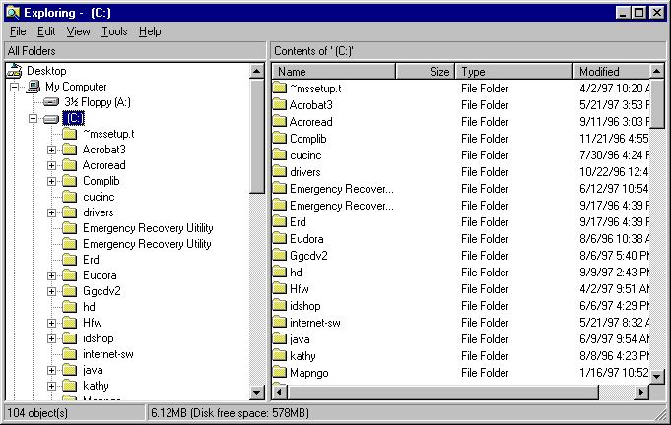
The Unix file system. A tree just like OSX and Windows
ARQ

Slide 11
I am lazy. You should be too. Shortcuts!!!
Go back to past commands with the arrow keys.
The history command will report the commands you have used in the past.
Type the "Ctrl" "r" keys at the same time to bring up a search for commands that contain search terms. Use the arrow keys to cycle through all commands that match the search term.
Use the "Tab" key for autocomplete - just like your smartphone!
Type the "Ctrl" "c" keys at the same time to kill a command.
ARQ

Slide 12

The ls command (list files and directories)
(What files and directories can be found in the current directory?)
ARQ
Imagine we are user “luke”
Luke’s home directory (shortcut: ~)
root
list luke’s home directory
$ ls
hi.txt proj1
home
bin
vol
command
result to standard
output (stdout)
luke
leia
ls
head
cat
hi.txt
proj1
Example Unix file system (a “tree”)
data1.txt
data2.txt

Slide 13
The ls command (list files and directories)
(What files and directories can be found in the current directory?)
ARQ
Example Unix file system (a “tree”)
Imagine we are user “luke”
Luke’s home directory
root
list luke’s home directory
$ ls
hi.txt proj1
list luke’s home directory
$ ls ~
hi.txt proj1
home
bin
vol
luke
leia
ls
head
cat
hi.txt
proj1
data1.txt
data2.txt

Slide 14
The cd command (change directories)
(cd helps to navigate through the Unix directory tree)
ARQ
Example Unix file system (a “tree”)
Image we are user “luke”
list luke’s home directory
$ ls
hi.txt proj1
root
move to luke’s “proj1” directory
$ cd proj1
list luke’s “proj1” directory
home
bin
vol
$ ls
data1.txt data2.txt
Move “up” the tree to luke’s home directory
$ cd ..
$ ls
hi.txt proj1
luke
leia
ls
head
cat
Move “up” the tree to the “usr” directory
$ cd ..
$ ls
luke leia
hi.txt
proj1
$ cd luke/proj1
Move directly to luke’s “proj1” directory
data1.txt
data2.txt
$ cd /bin
Move to the system “bin” directory

Slide 15
The pwd command (present working directory)
(Where am I? That is, in which directory am I?)
ARQ
Imagine we are user “luke”
Example Unix file system (a “tree”)
root
Where am I?
$ pwd
/home/luke
move to luke’s “proj1” directory
$ cd proj1
home
bin
vol
Where am I?
$ pwd
/home/luke/proj1
luke
leia
ls
head
cat
move back to luke’s home directory
$ cd ..
Where am I?
$ pwd
/home/luke
hi.txt
proj1
data1.txt
data2.txt

Slide 16
The mkdir command (make a new directory)
ARQ
Example Unix file system (a “tree”)
Imagine we are user “luke”
root
Where am I?
$ pwd
/usr/luke
List luke’s home directory
$ ls
Hi.txt proj1
home
bin
vol
Move to the “proj1” directory
$ cd proj1
luke
leia
ls
head
cat
$ mkdir data
Make a new “data” directory in proj1
hi.txt
proj1
data1.txt
data2.txt
data

Slide 17
The touch command (create an empty file)
ARQ
Example Unix file system (a “tree”)
Image we are user “luke”
root
Where am I?
$ pwd
/usr/luke
List luke’s home directory
$ ls
Hi.txt proj1
home
bin
vol
$ cd proj1/data
Move to the “proj1/data” directory
luke
leia
ls
head
cat
Create an empty text file called “frost.txt”
$ touch frost.txt
hi.txt
proj1
data1.txt
data2.txt
data
frost.txt

Slide 18
The head command
(peak at the first n lines in an input file or stream)
ARQ
The contents of test.txt
$ cat test.txt
$ head -n 5 test.txt
Hello world!
1
2
3
4
Hello world!
1
2
3
4
5
6
7
8
9
Goodbye world!
$ head -n 10 test.txt
(notice how the last line -- line 11 – is not printed here)
Hello world!
1
2
3
4
5
6
7
8
9

Slide 19
The head command
(peak at the first n lines in an input file or stream)
ARQ
-n is an argument or parameter to the head command that modulates its behavior. In this case to report the first 5 lines instead of the first 10, which is the default behavior
The contents of test.txt
$ head -n 5 test.txt
Hello world!
1
2
3
4
5
6
7
8
9
Goodbye world!
\n
\n
\n
\n
\n
\n
\n
\n
\n
\n
\n
Hello world!
1
2
3
4
$ head -n 10 test.txt
Hello world!
1
2
3
4
5
6
7
8
9
Important!
Each line ends with a special, hidden character called the newline (\n) character.
This is how “head” knows where the lines start and end.
Notes:
Go over special characters

Slide 20
Convention: The "$" at the beginning of each command represents the shell prompt. Don't copy/paste it.
ARQ
$ head -n 10 frost.txt

Slide 21
What do you think the tail command does?
ARQ

Slide 22
The cat command
(report every line in an input file or stream)
ARQ
$ cat test.txt
Hello world!
1
2
3
4
5
6
7
8
9
Goodbye world!

Slide 23
The cat command: add line numbers with -n
(report every line in an input file or stream)
ARQ
$ cat -n test.txt
1 Hello world!
2 1
3 2
4 3
5 4
6 5
7 6
8 7
9 8
10 9
11 Goodbye world!

Slide 24
The wc command
(count the lines, words, and bytes in a file or stream)
ARQ
$ cat test.txt
How many lines words and bytes (characters) in test.txt?
$ wc test.txt
12 13 47 test.txt
Hello world!
1
2
3
4
5
6
7
8
9
Goodbye world!
How many lines (-l) in test.txt?
$ wc -l test.txt
12 test.txt
How many characters (-c) in test.txt?
$ wc -c test.txt
47 test.txt
Think: Is this the same as the number of nucleotides in the sequence?

Slide 25
Vim
The old-fashioned way of text editing
Can be tricky and annoying, but at times useful
We will use this again in the future and get more practice with it

Slide 26
Diving into Vim
$ vim text.txt <-- let’s write new file
Commands:
You will start in viewer mode
Tap “d” twice = delete a line
Arrow keys to move cursor
Tap “i” to enter editor mode
Write your code
Press escape to exit editor mode
Type “:wq” to save (write) and quit
Type “:q” to quit without saving
If you made changes and want to quit without saving, you will need to use “:q!”

Slide 27
Homework
Review commands from today

